Slide 1

Contact Management System
Marist Database Administrators (DBA’s)
Database Management Systems - MSCS 542L - Dr. Reza Sadeghi
noah.carbo1@gmail.com - https://github.com/NoahCarboMarist/MSCS542_ContactManagementSystem_ContactManagers
12/07/22

Slide 2
Outline
Team Description ……………………………………………………………………………. 3
System Description …………………………………………………………………………. 4
Entity Relationship Model (ER Model) ……………………………...…………………….. 5
Enhanced Entity Relationship Model (EER Model) ……………………………………… 6
Database Development …………………………………………………………………….. 7-13
Loading Data and Performance Enhancements …………………………………………. 14-15
Manipulating the Data ……………………………………………………………………….. 16
Graphical User Experience Design …………………...……………..…………………….. 17
Graphical User Interface Design ……...……………………………..…………………….. 18-32
References …………………………………………………………………………………… 33

Slide 3
Team Description Page
Noah Carbo
My name is Noah Carbo, I am working on my master’s in Software Development at Marist College. I wanted to work with my group based on their proximity to where I sat on the first day of class. Everyone on the team seems very competent in their fields and we have agreed on communicating through Whatsapp while working on this project. I am looking forward to working with everyone this semester.
Theresa Gundel
I graduated from Binghamton University in 2021 with a Bachelor’s in Computer Science. Now I am pursuing a Master’s in Computer Science at Marist College. I did not know anyone in the class beforehand so I chose to work with this group because we were sitting near each other in class. We chose Noah as Team Head because he volunteered first and seemed like a good fit.
Ryan Weidling
My name is Ryan and I am working on my second degree from Marist. I graduated in 2018 with a Bachelor’s in Communications and am now pursuing a Master’s in Computer Science to pursue a career in software engineering. I wanted to work with the current group members because of two reasons. One, they were in close proximity to me, and two, each person at some point in the first two weeks had demonstrated qualities that would make them great teammates. Whether that was showing friendliness by introducing themselves when we sat down, or sharing their background and proving their technical prowess. We chose Noah as Team lead because when the project was announced he was already brainstorming ideas for what our group should be working on.
Dale Doster
In 2020, I graduated with a degree in Computer Science from Marist College. My focus in undergrad was on Software Development. After having worked as a Software Engineer for the past couple years, I decided to pursue a Master’s degree, again with a focus on Software Development. I decided to work with my team because they were sitting near me and were easily approachable. We decided to select Noah as the Team Head because he volunteered and has good communication skills.
Sai sumanth Gurrala
I am Sai Sumanth, I graduated with a bachelors in computer science from Bharath University, India. I am currently working with my group members for the Database management project, because we were sitting together in class. And it made more sense once we got connected through a whatsapp group and shared our interests and work. I am confident that my team members are very competitive and together we can bring the most out of ourselves for the project of contact management system. We chose Noah as our team head, because we felt he was more capable of leading our team towards our goal.
Thomas Diaz-Piedra
My name is Thomas. I graduated from Marist with a bachelors in computer science and minors in information systems and information technology last year. I wanted to work with my group mates because we all sat near each other on the first couple days of classes and we all seemed to have the same outlook when it came to this project. We chose Noah as the team head/leader as he volunteered to do it and seemed more than capable of doing the job. Really looking forward to working with this team this semester.
Banu Pitta Reddy
My name is Banu Prakash, I graduated with a bachelors in Mechanical engineering from Jawaharlal Nehru Technological University, India. I have worked as a Software Quality Engineer for almost 9 years and decided to pursue my masters degree with focus on Cloud Computing. I met only a few mates in the class and found these people enthusiastic about the work. We spent some time sharing our interests and work, where I got to know more about my team members. Everyone in the team looks to be goal oriented and working towards a common objective. We chose Noah to head the team as he volunteered to do it and we trust his efficiency with the level of confidence that he demonstrates. I am very excited to join the team and looking forward to a great collaboration in completing this project.

Slide 4
System Description Page
Allows for admin access with a secure credentials and include the following abilities
To add/edit additional admins
Add and delete user profiles
Edit and manage user information
Allows for resetting usernames/passwords in the event the user locks themselves out of their accounts
Allows for users to customize their stored information with the following capabilities
Add/Delete multiple contact information
Allows for editing of saved contact information
Contacts can be searched based on their specific details
The CMS has a Graphical User Interface (GUI) which allows for interaction between the user and the database
The GUI prevents duplicate contacts to be added
It is user friendly including a welcome screen, provides reports in a tabular form and allows the user to exit the program.
Sensitive user information is ciphered so that in the unfortunate event of a hack of our user information the data that is collected would be indecipherable.

Slide 5
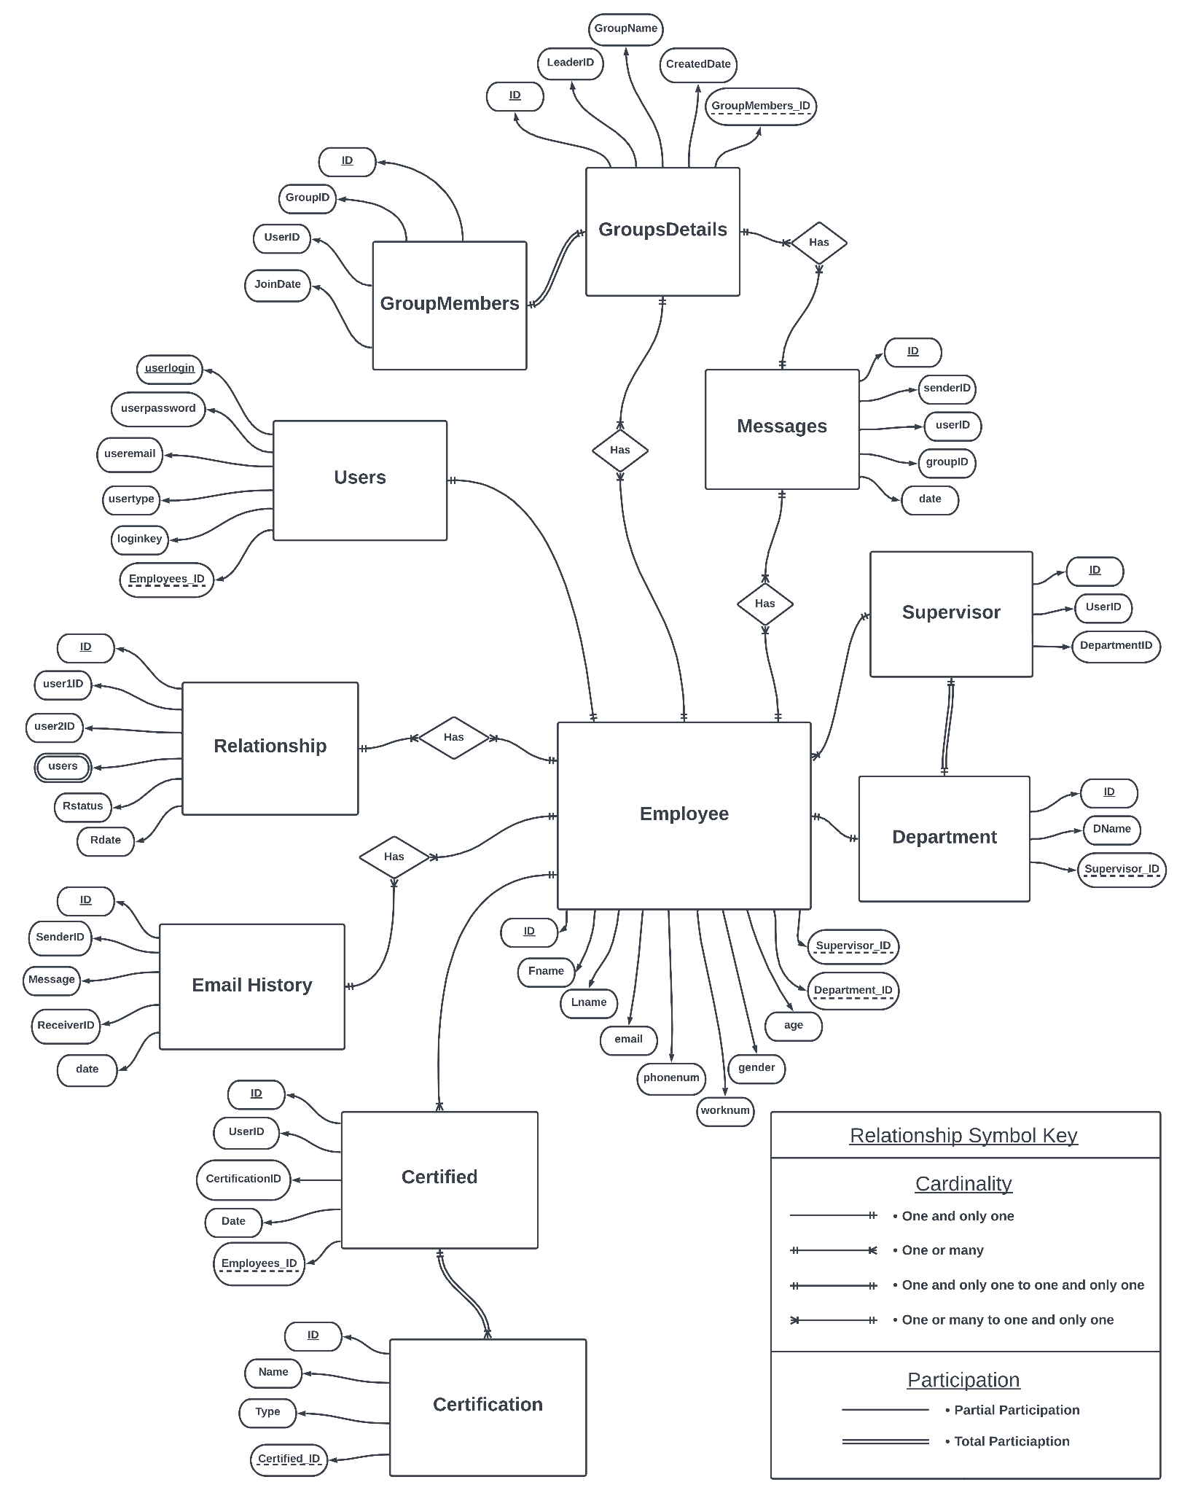
Entity Relationship Model

Slide 6
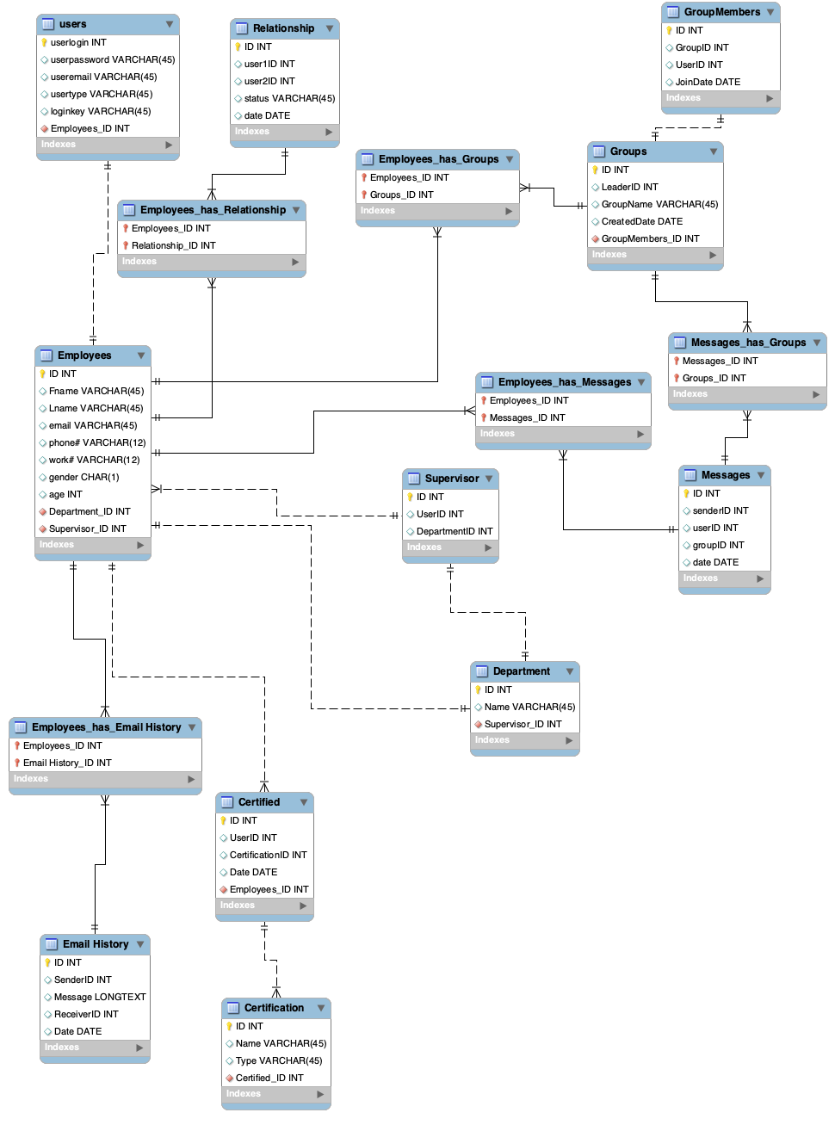
Enhanced
Entity Relationship Model

Slide 7
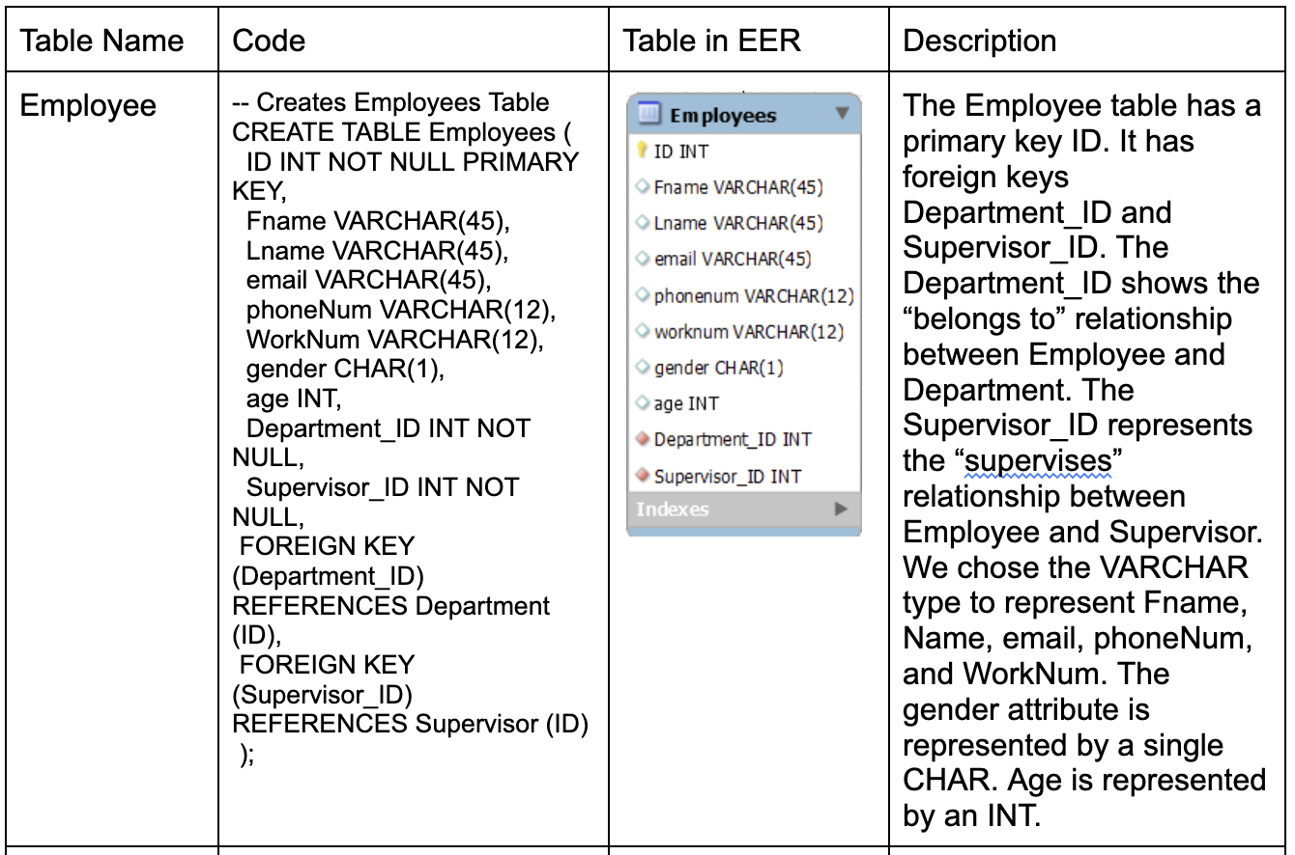
SQL Database Development
We developed the database by first creating tables and defining the variable types and keys
The employees table is the largest table with the most relationships as shown. The rest of the tables were created in the same fashion as this one

Slide 8
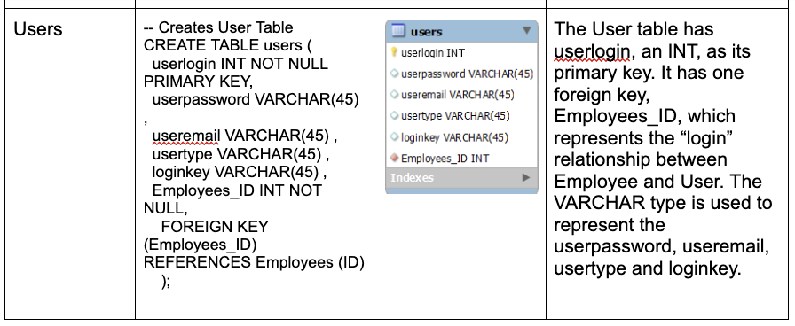
SQL Database Development (Cont.)

Slide 9
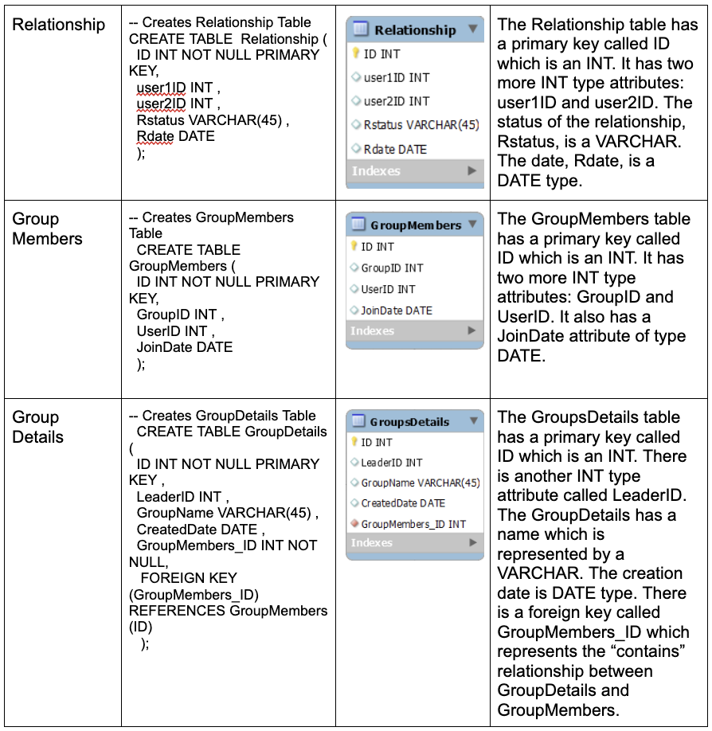
SQL Database Development (Cont.)

Slide 10
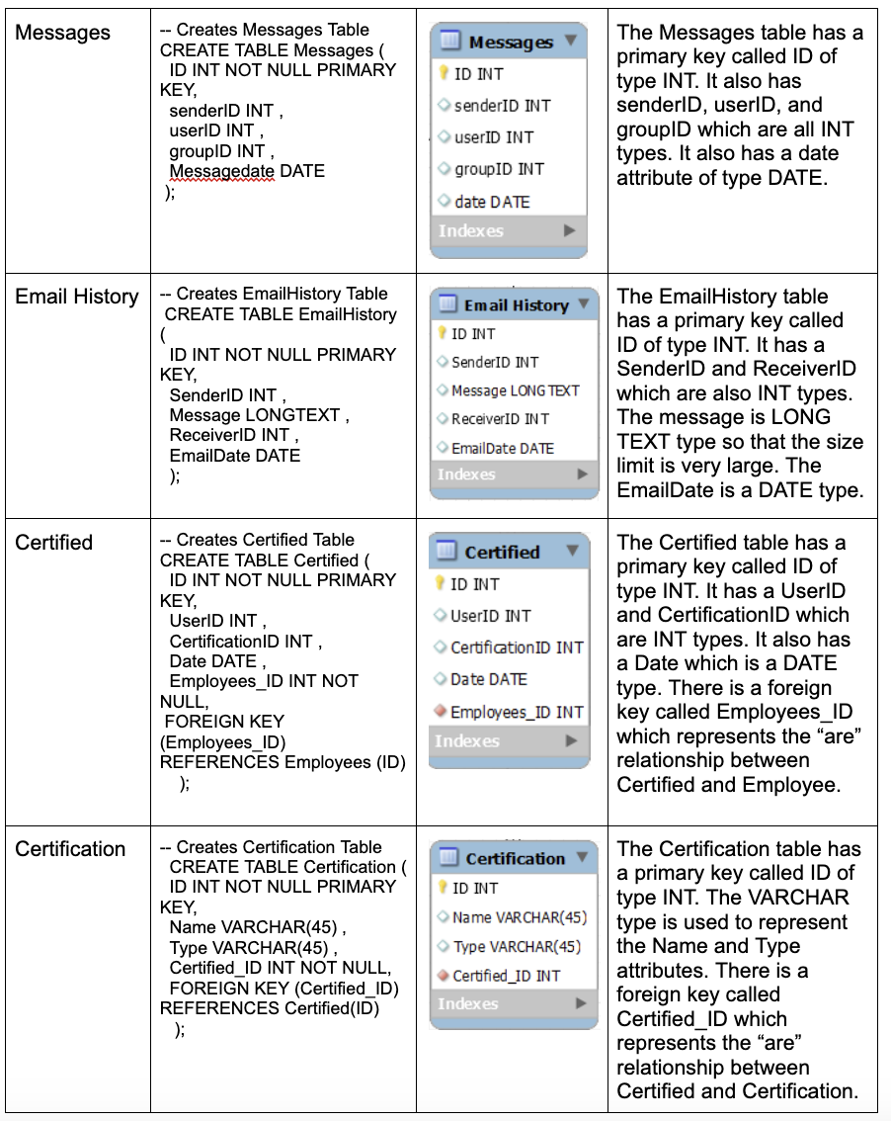
SQL Database Development (Cont.)

Slide 11
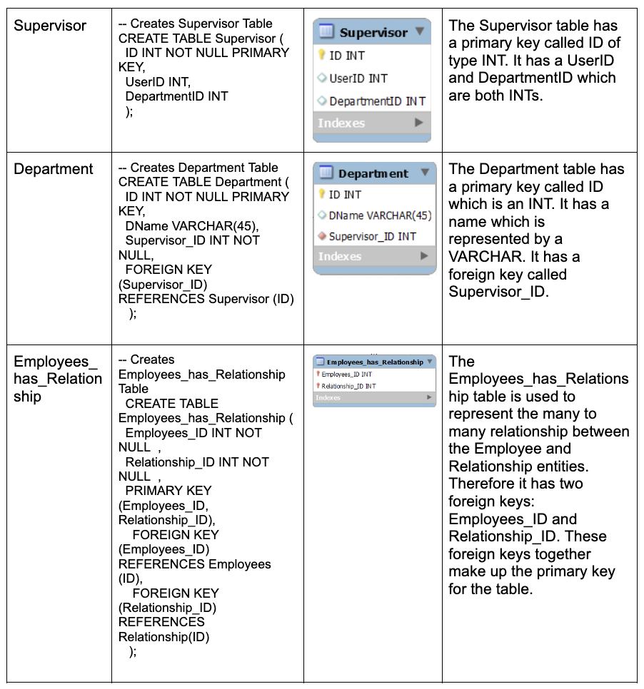
SQL Database Development (Cont.)

Slide 12
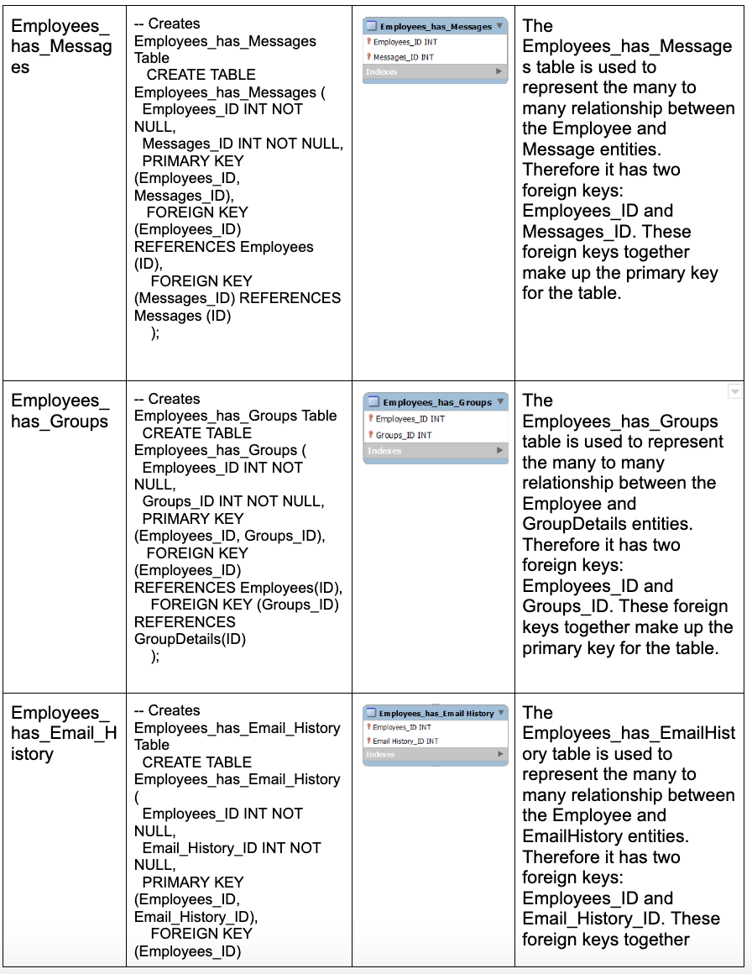
SQL Database Development (Cont.)

Slide 13
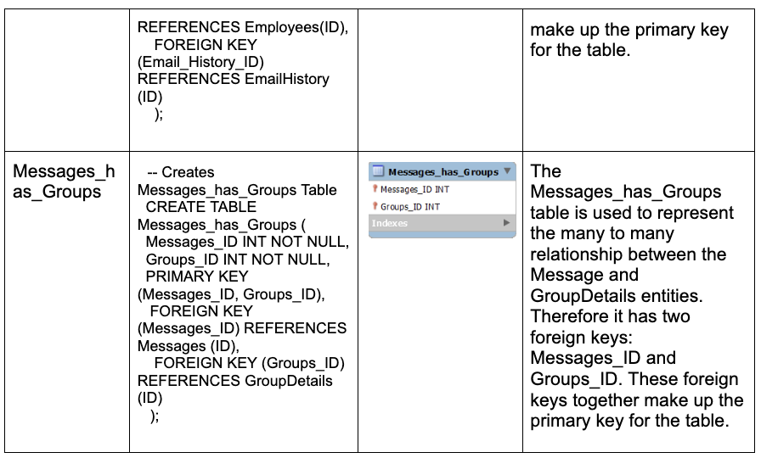
SQL Database Development (Cont.)

Slide 14
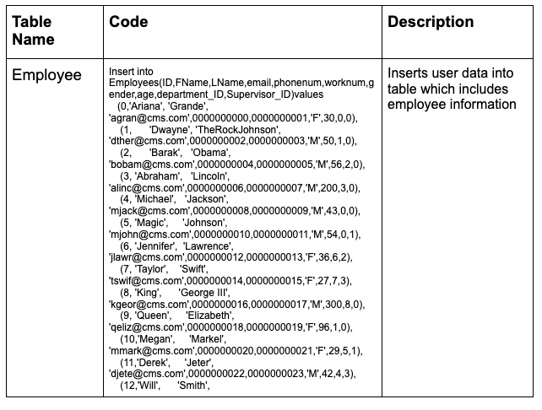
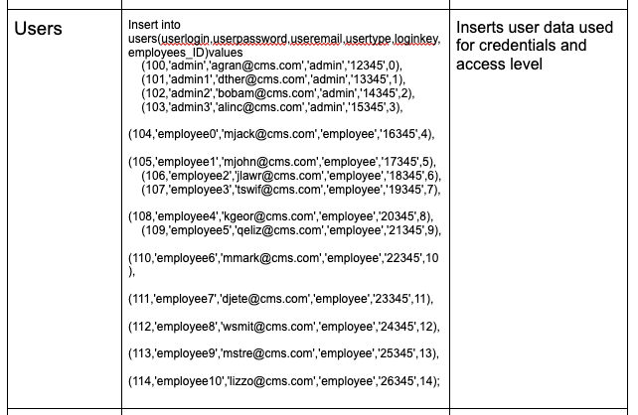
Loading Data & Performance Enhancements
The data is inserted into the tables by first turning off the Foreign_Key_Check which allows data to be inserted without triggering a foreign key issue

Slide 15
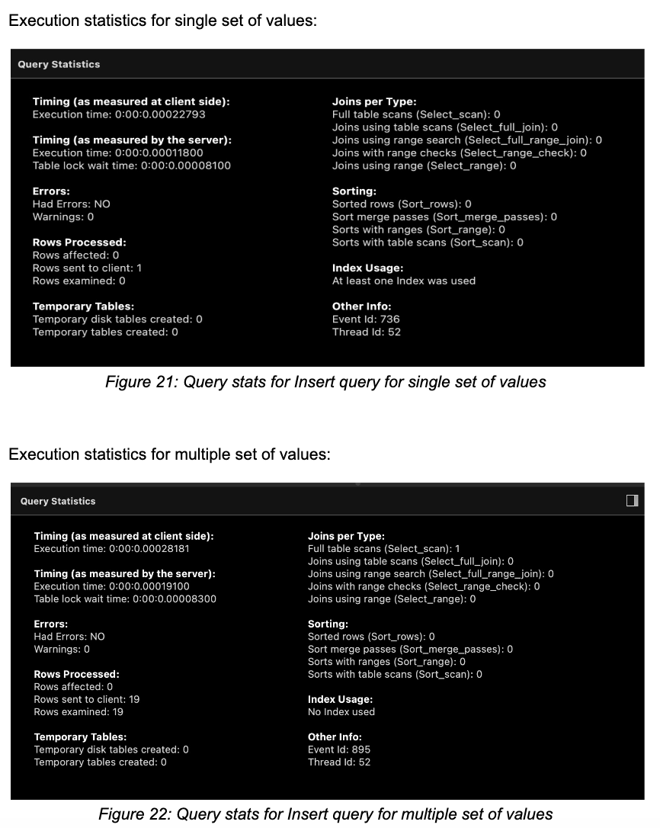
Loading Data & Performance Enhancements (Cont.)
Regarding insert query
The time required for insertion is determined by following factors; Connecting, Sending query to server, Parsing query, Inserting row: (1 × size of row), Inserting indexes: (1 × number of indexes), Closing.
In the insertion of records into the employee table, we are using the insert query multiple times for each insertion of record. So, this type of insertion will consume additional time in inserting the records since this query has to go through all of the factors like connecting, sending query to server, parsing query, inserting row, inserting indexes and closing.
For the insertion of multiple instances using a single insert query, this reduces the time for the execution since we only have to go through the process of insertion into the database all at once.

Slide 16
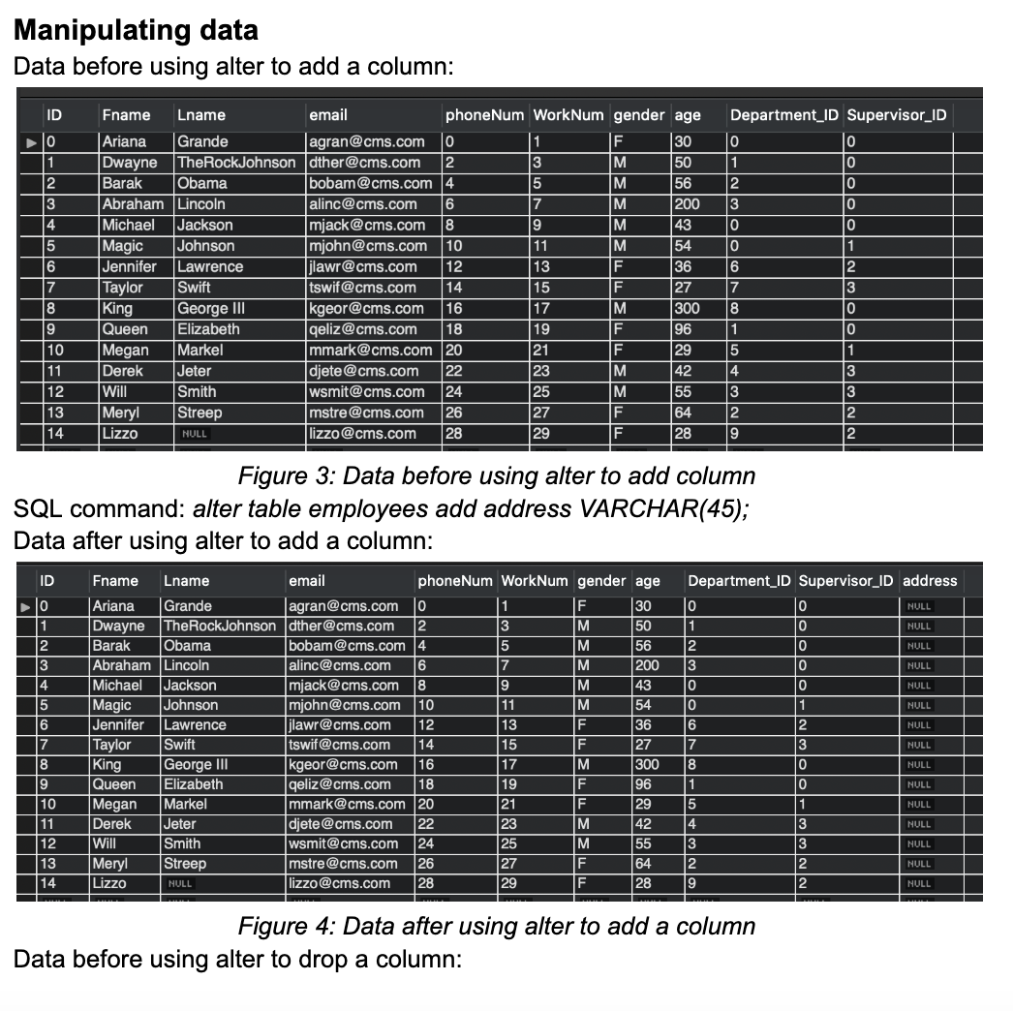
Manipulating the Data

Slide 17
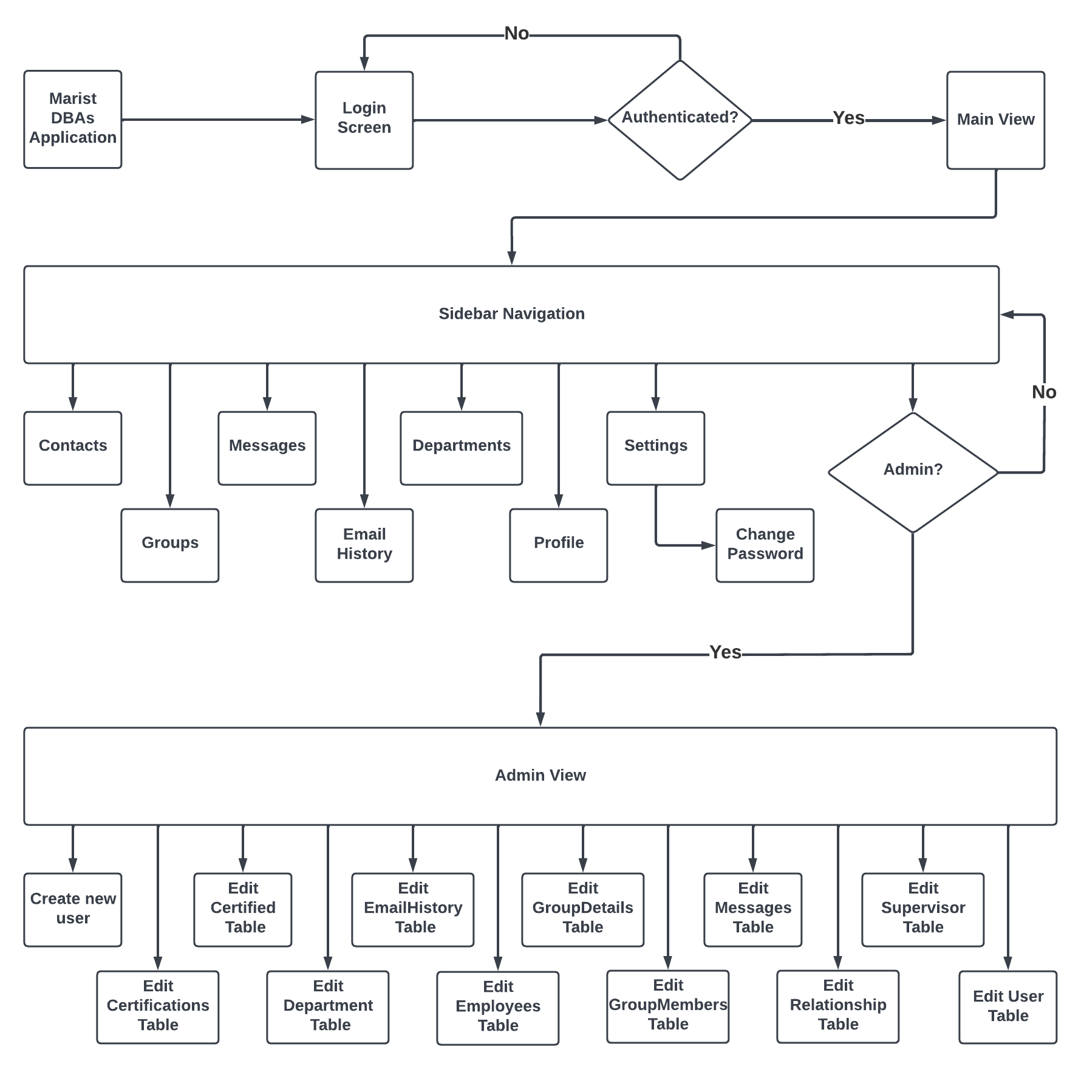
Graphical User Interface
Experience Design:

Slide 18
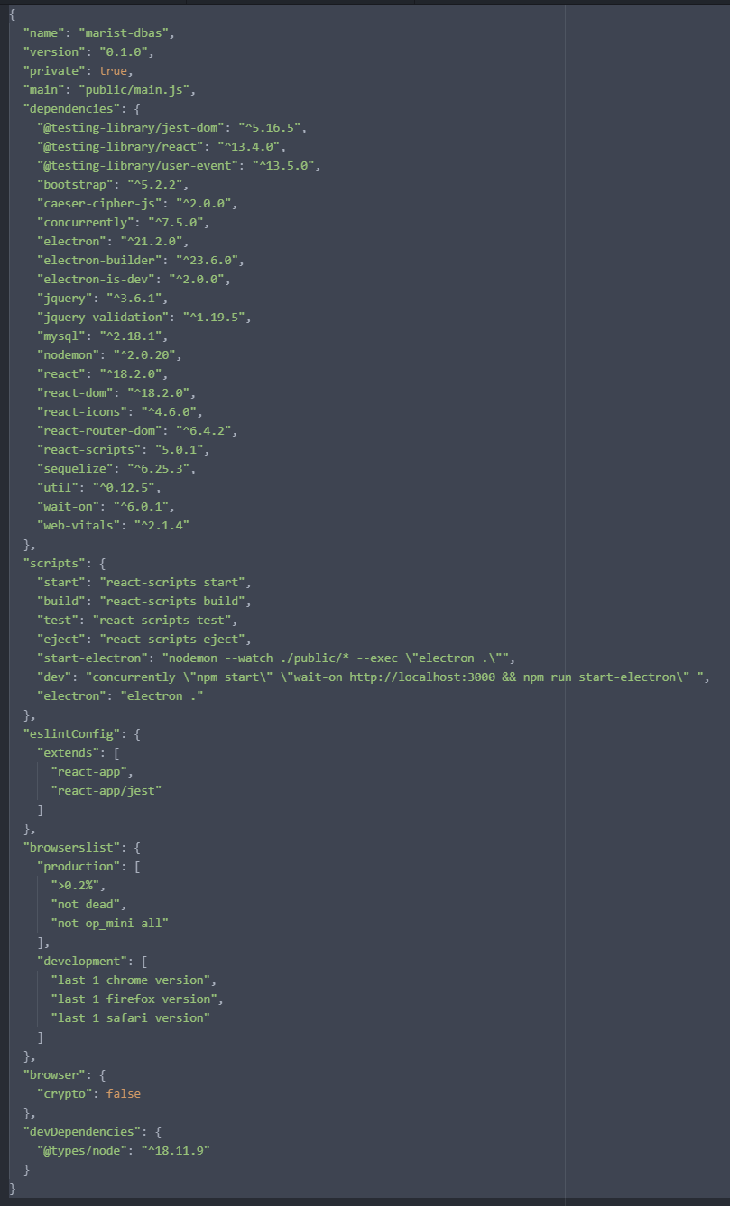
Graphical User Interface
Implementation:
Node.js
package.json

Slide 19
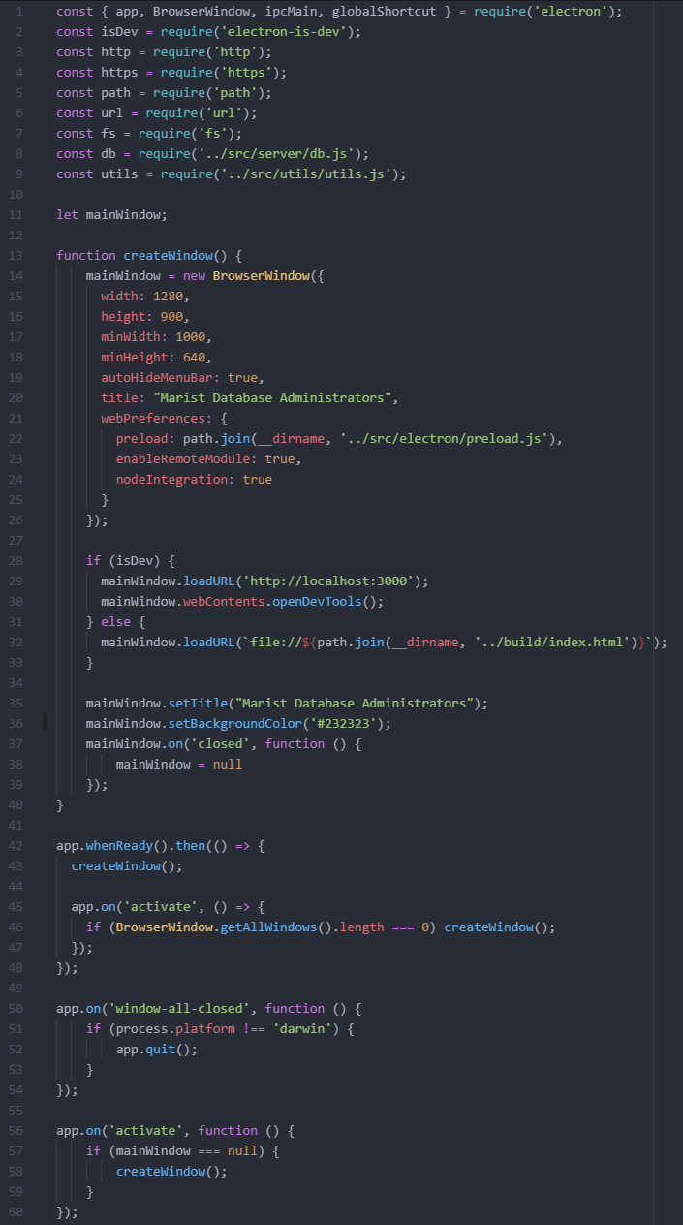
Graphical User Interface
Implementation:
Electron.js
Framework for windowed application
Handles Routing
ContextBridge
Inter-Process Communication (IPC)
ipcMain
ipcRenderer

Slide 20
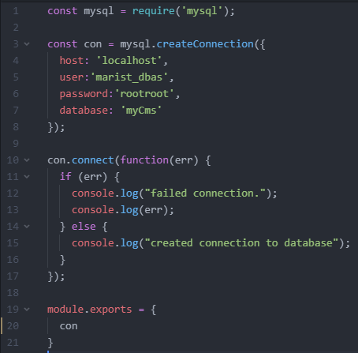
Graphical User Interface
Implementation:
MySQL
JS package used to establish connection to MySQL server

Slide 21
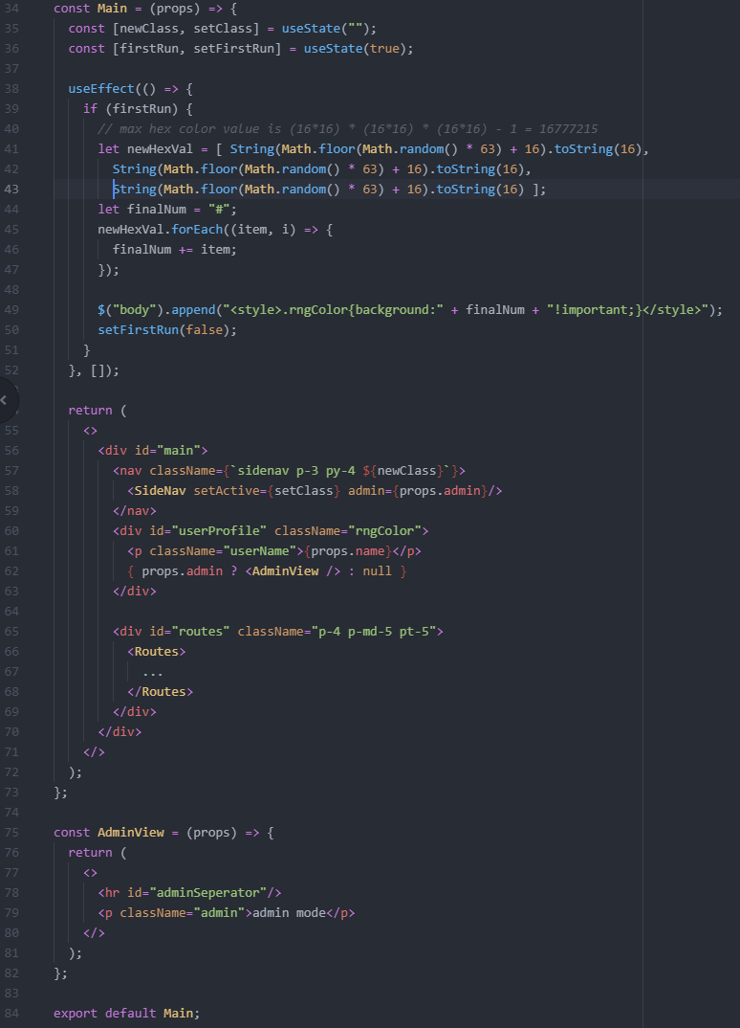
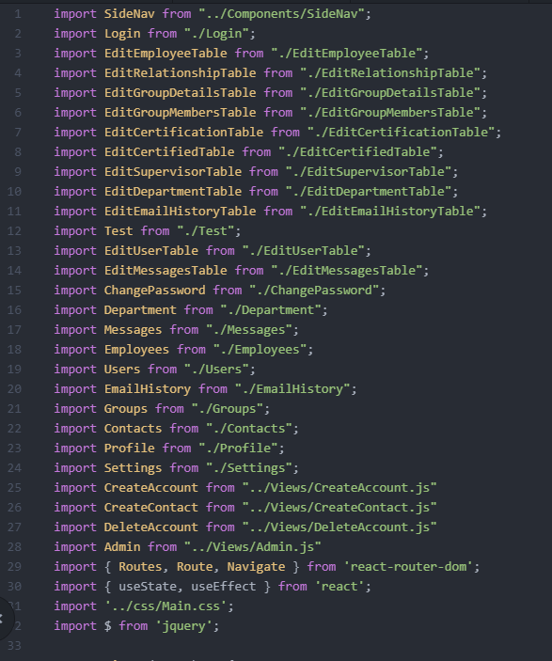
Graphical User Interface
Implementation:
React.js

Slide 22
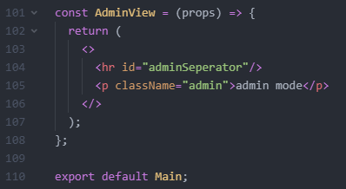
Graphical User Interface
Implementation:
React.js

Slide 23
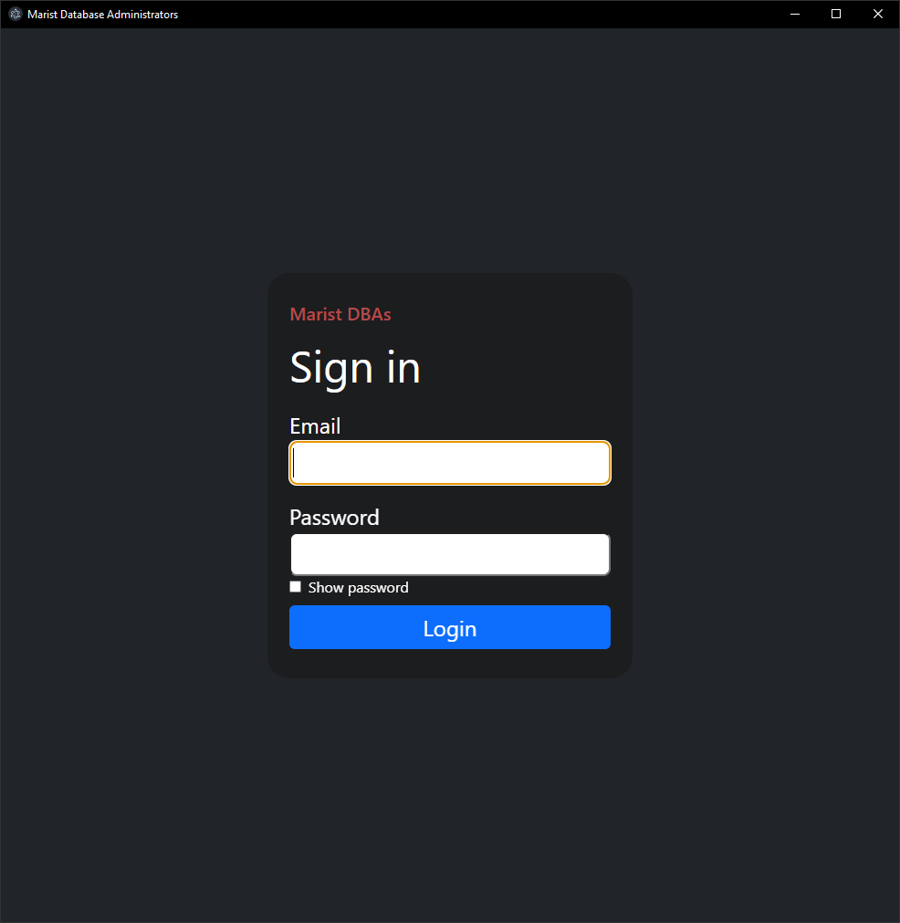
Graphical User Interface
Login Page:

Slide 24
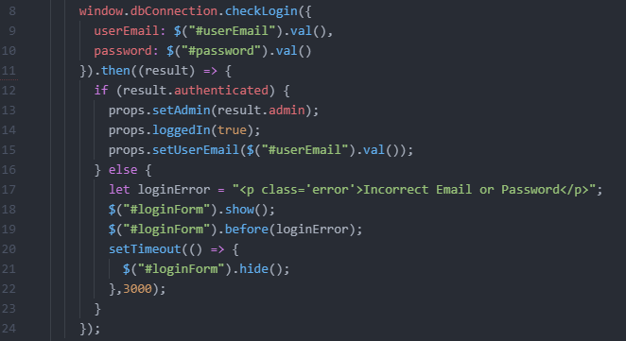
Graphical User Interface
Login Page:

Slide 25
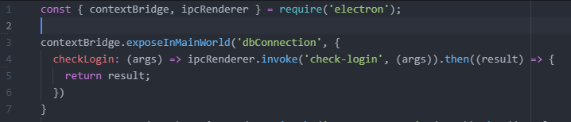
Graphical User Interface
Preload:

Slide 26
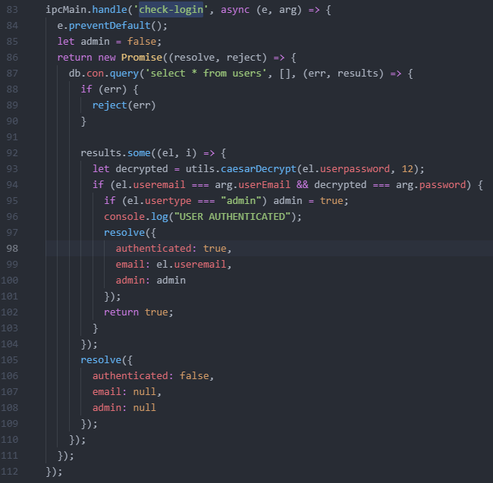
Graphical User Interface
Main Process:

Slide 27
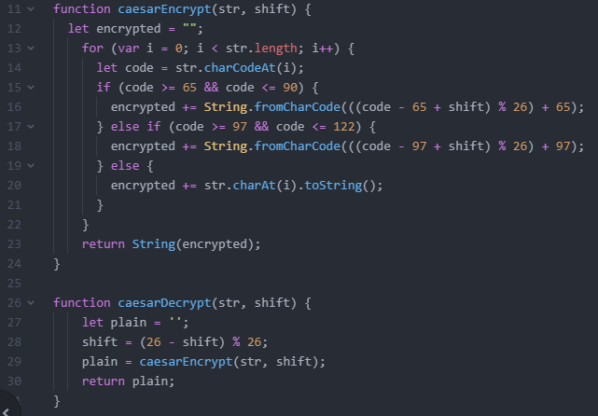
Graphical User Interface
Caesar Cipher:

Slide 28
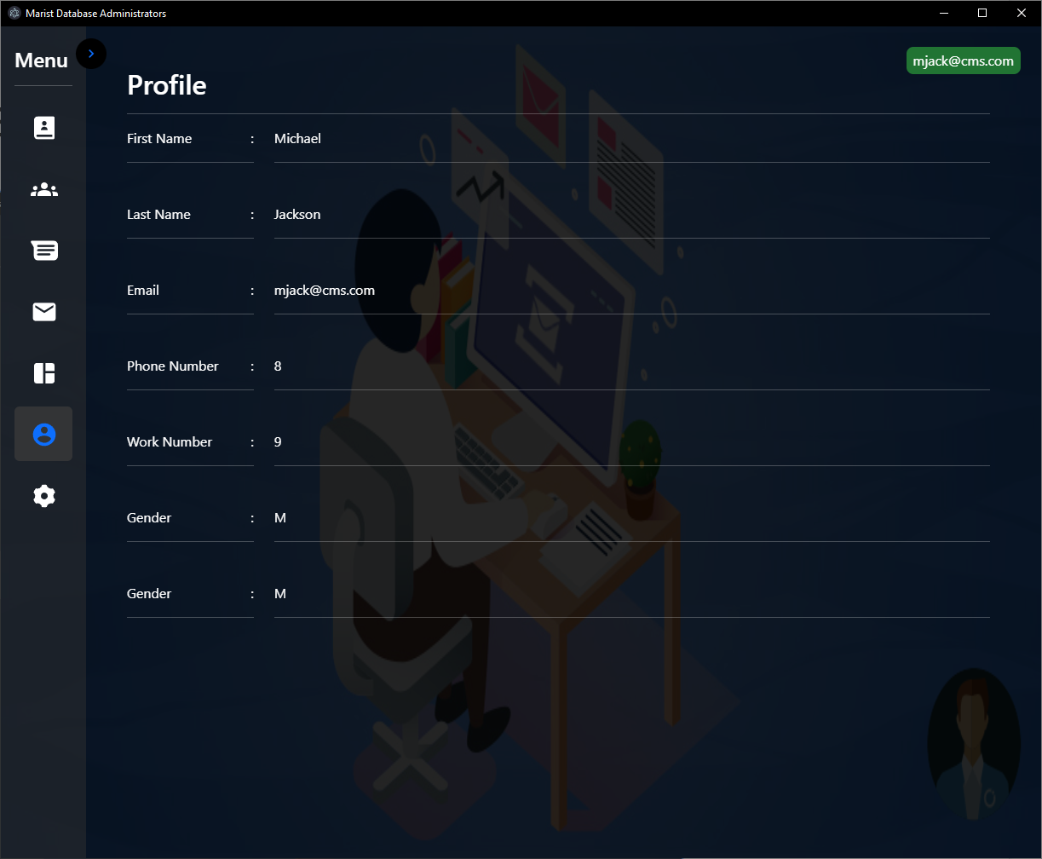
Graphical User Interface
Normal User View:

Slide 29
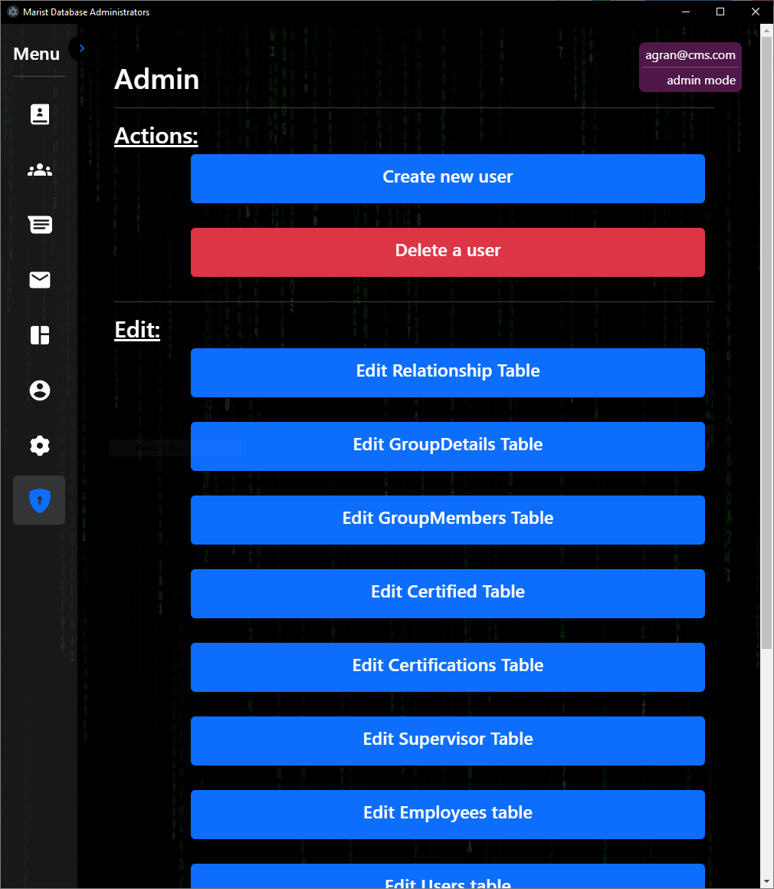
Graphical User Interface (Cont)
Admin View:

Slide 30
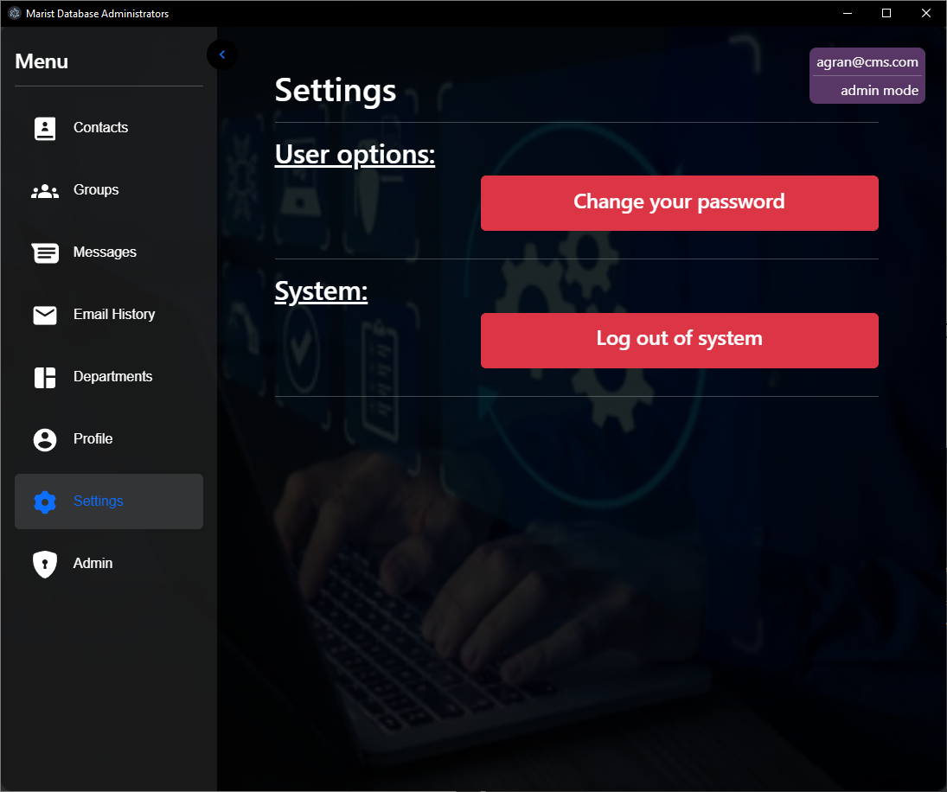
Graphical User Interface
User Settings:

Slide 31
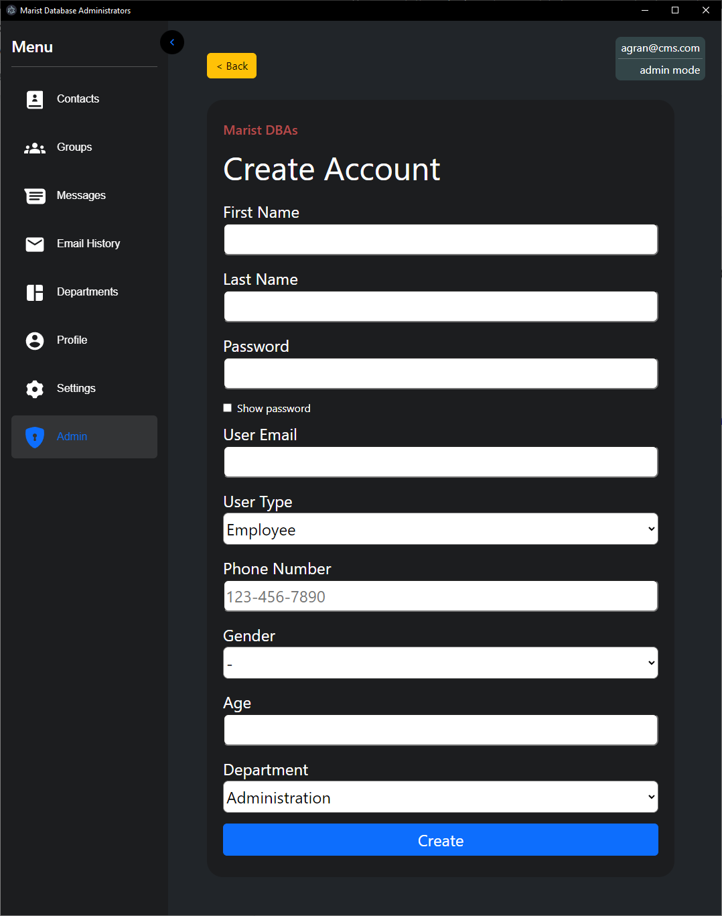
Graphical User Interface
Add User View:

Slide 32
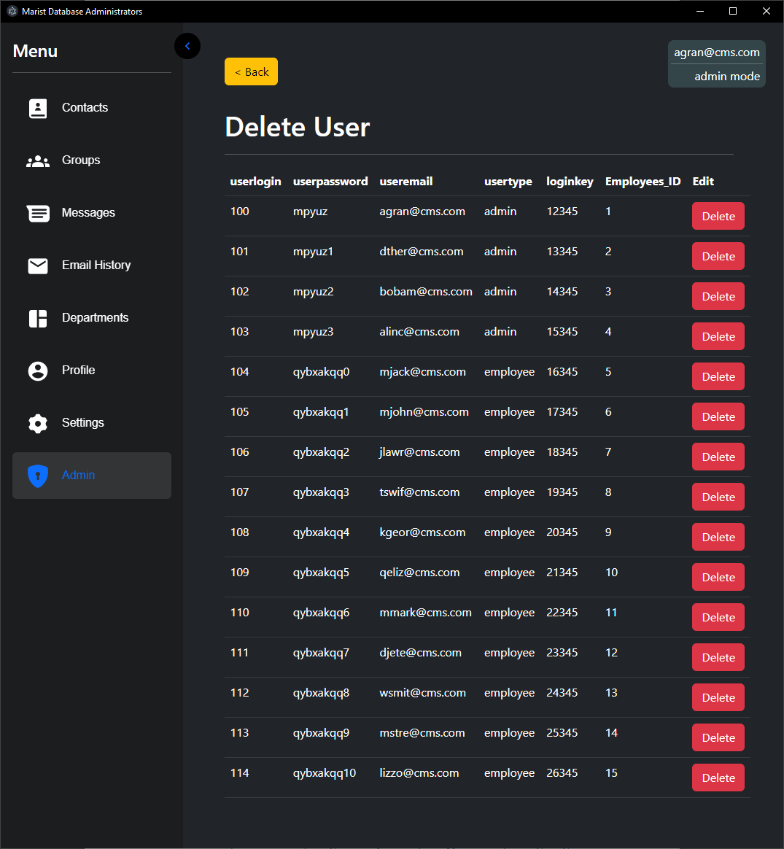
Graphical User Interface
Delete User View:

Slide 33
References
[1] Fuchs, Jay. “The 14 Best Contact Management Software Tools in 2022.” HubSpot Blog, HubSpot, 2 Sept. 2022, https://blog.hubspot.com/sales/contact-management-software.
[2] Keap, 2022, https://keap.com/features/client-management.
[3] Scheiner, Michael. “Keap CRM Review: Keap Software Prices, Features, Pros & Cons.” CRM.org, 23 May 2022, https://crm.org/news/keap-crm-review.
[4] Scheiner, Michael. “Streak CRM Review: Pricing, Pros & Cons of Streak for Gmail Chrome Extension.” CRM.org, 8 Feb. 2022, https://crm.org/news/streak-crm-review.
[5] Singleton, Chris. “Nimble CRM Review (2022) - Full Pros and Cons.” Style Factory, 25 Jan. 2022, https://www.stylefactoryproductions.com/blog/nimble-crm-review.
[6] “DBMS Keys: Primary, Foreign, Candidate and Super Key - Javatpoint.” www.javatpoint.com, www.javatpoint.com/dbms-keys. Accessed 3 Oct. 2022.
[7] “Primary and Foreign Key Constraints - SQL Server.” Microsoft Learn, 17 Aug. 2022, learn.microsoft.com/en-us/sql/relational-databases/tables/primary-and-foreign-key-constraints?view=sql-server-ver16.
[8] Techopedia. “Relationship.” Techopedia.com, 23 Sept. 2014, www.techopedia.com/definition/24438/relationship-databases#:%7E:text=A%20relationship%2C%20in%20the%20context,while%20linking%20disparate%20data%20items.
[9] “Intelligent Diagramming.” Lucidchart, https://www.lucidchart.com/pages/.

